Slide 1
String
String is a class that create an immutable object that contain sequence of character and are final . Immutable simply means unmodifiable or unchangeable.
String class is used to create string object
There are two ways to create String object:
By string literal –
Each time you create a string literal, the JVM checks the string constant pool first. If the string already exists in the pool, a reference to the pooled instance returns. If the string does not exist in the pool, a new String object instantiates, then is placed in the pool.
By new keyword
In such case, JVM will create a new String object in normal(nonpool) Heap memory and the literal "Welcome" will be placed in the string constant pool using intern() The variable s will refer to the object in Heap(nonpool).
String s= “Hello”;
String s=new String("Welcome");//creates two objects and one reference variable
Notes:
String is a Class in java and defined in java.lang package
Note: String objects are stored in a special memory area known as string constant pool inside the Heap memory.
A String represents a string in the UTF-16 format
The java.lang.String class implements Serializable, Comparable and CharSequence interfaces.

Slide 2
String
String is a final class with all the fields as final except “private int hash”. This field contains the hashCode() function value and created only when hashCode() method is called and then cached in this field.
Notes:
Furthermore, hash is generated using final fields of String class with some calculations, so every time hashCode() method is called, it will result in same output. For caller, its like calculations are happening every time but internally it’s cached in hash field.

Slide 3
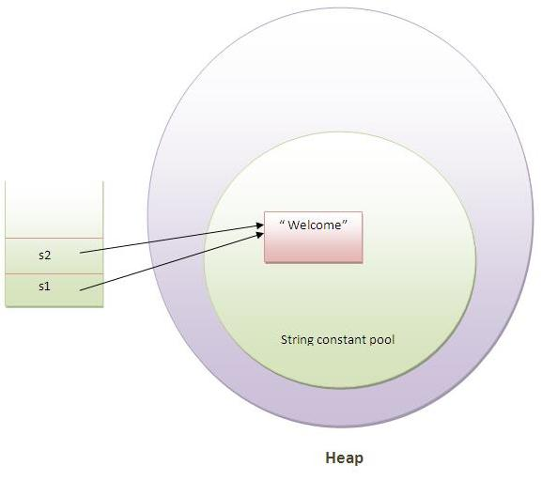
String (cont.)
String s1="Welcome";
String s2="Welcome";//no new object will be created

Slide 4
String class Methods
trim() method eliminates white spaces before and after string
startsWith() and endsWith() method return boolean if true
charAt() method returns a character at specified index.
length() method returns length of the string.
String intern() method is used to add string literal to string pool if it created using new key.
string valueOf() method coverts given type such as int, long, float, double, boolean, char and char array into string
substring(int begin) -
Notes:
Str = “0123456789”
str.substring(6));// 6789
Str.substring(3,7)://3456

Slide 5
Why String is Immutable Java
Java use the concept of string literal and JVM use string interning concept to store string in a special are called string intern pool.
String interning concept is the method of storing. It state only one copy of distinct string value which must be immutable can store. Interning strings makes string processing task more time- or space-efficient. The distinct values are stored in a string intern pool.
If String would not have been immutable, then String interning would not have been possible because if any variable would have changed the value, it would have been reflected to other variables also.
If String is not immutable then it would cause severe security threat to the application.
String is immutable, it is safe for multithreading and a single String instance can be shared across different threads. This avoid the usage of synchronization for thread safety, Strings are implicitly thread safe.
Notes:
string interning is an example of the flyweight design pattern:
Flyweight is a software design pattern. A flyweight is an object that minimizes memory use by sharing as much data as possible with other similar objects

Slide 6
Why String is Immutable Java
String is immutable, its hashcode is cached at the time of creation and it doesn’t need to be calculated again. This makes it a great candidate for key in a Map and it’s processing is fast than other HashMap key objects. This is why String is mostly used Object as HashMap keys.
Once string object is created its data or state can't be changed but a new string object is created.
class Simple{
public static void main(String args[]){
String s="Sachin";
s.concat(" Tendulkar");//concat() method appends the string at the end
System.out.println(s);//will print Sachin because strings are immutable objects
}
}
Heap
String contant pool
s
Sachin
Sachin Tendulkar
Notes:
if we explicitely assign it to the reference variable, it will refer to "Sachin Tendulkar" object.
In such case, s points to the "Sachin Tendulkar". But still sachin object is not modified
Why string objects are immutable in java?
Because java uses the concept of string literal. Suppose there are 5 reference variables,all referes to one object "sachin".If one reference variable changes the value of the object, it will be affected to all the reference variables. That is why string objects are immutable in java.

Slide 7
String comparison
We can compare two given strings on the basis of content and reference
There are three ways to compare String objects:
By equals() method
By = = operator
By compareTo() method
By equals() method
equals() method compares the original content of the string
String class provides two methods:
public boolean equals(Object another){} compares this string to the specified object.
public boolean equalsIgnoreCase(String another){} compares this String to another String, ignoring case.

Slide 8
String comparison
By == operator
compares references not values
class Simple{
public static void main(String args[]){
String s1="Sachin";
String s2="Sachin";
String s3=new String("Sachin");
System.out.println(s1==s2);//true (because both refer to same instance)
System.out.println(s1==s3);//false(bcz s3 refers to instance created in nonpool)
}
}

Slide 9
compareTo() method
compareTo() method compares values and returns an int which tells if the values compare less than, equal, or greater than
Suppose s1 and s2 are two string variables.If:
s1 == s2 :0 s1 > s2 :positive value s1 < s2 :negative value
class Simple{
public static void main(String args[]){
String s1="Sachin";
String s2="Sachin";
String s3="Ratan";
System.out.println(s1.compareTo(s2));//0
System.out.println(s1.compareTo(s3));//1 (because s1>s3)
System.out.println(s3.compareTo(s1));//-1 (because s3 < s1 )
}
}

Slide 10
String Concatenation
Concating strings form a new string i.e. the combination of multiple strings
There are two ways to concat string objects:
By + (string concatenation) operator
By concat() method
By + (string concatenation) operator
Compiler transformation
class Simple{
public static void main(String args[]){
String s="Sachin"+" Tendulkar";
System.out.println(s); //Sachin Tendulkar
String s2=50+30+"Sachin"+40+40;
System.out.println(s2);//80Sachin4040
}
}
String s=(new StringBuilder()).append("Sachin").append(" Tendulkar).toString();
Notes:
String concatenation is implemented through the StringBuilder(or StringBuffer) class and its append method.String concatenation operator produces a new string by appending the second operand onto the end of the first operand.The string concatenation operator can concat not only string but primitive values also.
Note:If either operand is a string, the resulting operation will be string concatenation. If both operands are numbers, the operator will perform an addition.

Slide 11
By concat() method
concat() method concatenates the specified string to the end of current string.
Syntax:public String concat(String another){}

Slide 12
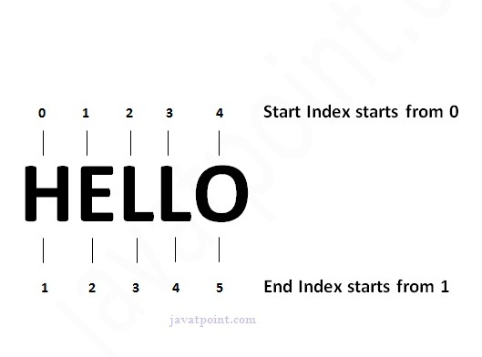
Substring
A part of string is called substring.
substring is a subset of another string.
In case of string:
startIndex: starts from index 0(inclusive). endIndex: starts from index 1(exclusive).
public String substring(int startIndex)
public String substring(int startIndex,int endIndex)
class Simple{
public static void main(String args[]){
String s="Sachin Tendulkar";
System.out.println(s.substring(6)); //Tendulkar
System.out.println(s.substring(0,6)); //Sachin
}
}

Slide 13
StringBuffer class
The StringBuffer class is used to created mutable (modifiable) string. The StringBuffer class is same as String except it is mutable i.e. it can be changed.
Note: StringBuffer class is thread-safe i.e. multiple threads cannot access it simultaneously .So it is safe and will result in an order.
Notes:
Since String is immutable in java, whenever we do String manipulation like concat, substring etc, it generates a new String and discard the older String for garbage collection. These are heavy operations and generate a lot of garbage in heap. So Java has provided StringBuffer and StringBuilder class that should be used for String manipulation. StringBuffer and StringBuilder are mutable objects in java and provide append(), insert(), delete() and substring() methods for String manipulation.

Slide 14
public synchronized StringBuffer append(String s): is used to append the specified string with this string. It is overloaded like append(char), append(boolean), append(int), append(float) etc. public synchronized StringBuffer insert(int offset, String s): is used to insert the specified string with this string at the specified position. The insert() method is overloaded like insert(int, char), insert(int, boolean), insert(int, int), insert(int, float), insert(int, double) etc. public synchronized StringBuffer replace(int startIndex, int endIndex, String str): is used to replace the string from specified startIndex and endIndex. public synchronized StringBuffer delete(int startIndex, int endIndex): is used to delete from specified startIndex and endIndex. public synchronized StringBuffer reverse(): is used to reverse str public int capacity(): is used to return the current capacity. public void ensureCapacity(int minimumCapacity): is used to ensure the capacity at least equal to the given minimum. public char charAt(int index): is used to return the character at the specified position. public int length(): is used to return the length of the string i.e. total number of characters. public String substring(int beginIndex): is used to return the substring from the specified beginIndex. public String substring(int beginIndex, int endIndex): is used to return the substring from the specified beginIndex and endIndex.

Slide 15
StringBuilder class
StringBuilder class is used to create mutable (modifiable) string. The StringBuilder class is same as StringBuffer class except that it is non-synchronized. It is available since JDK1.5

Slide 16
Difference between StringBuffer and StringBuilder
StringBuffer is thread safe and synchronize but StringBuilder class is non-synchronized.
StringBuilder is available since JDK1.5
Notes:
For String manipulations in non-multi threaded environment, we should use StringBuilder else use StringBuffer class.

Slide 17
public StringBuilder append(String s): is used to append the specified string with this string. The append() method is overloaded like append(char), append(boolean), append(int), append(float), append(double) etc. public StringBuilder insert(int offset, String s): is used to insert the specified string with this string at the specified position. The insert() method is overloaded like insert(int, char), insert(int, boolean), insert(int, int), insert(int, float), insert(int, double) etc. public StringBuilder replace(int startIndex, int endIndex, String str): is used to replace the string from specified startIndex and endIndex. public StringBuilder delete(int startIndex, int endIndex): is used to delete the string from specified startIndex and endIndex. public StringBuilder reverse(): is used to reverse the string. public int capacity(): is used to return the current capacity. public void ensureCapacity(int minimumCapacity): is used to ensure the capacity at least equal to the given minimum. public char charAt(int index): is used to return the character at the specified position. public int length(): is used to return the length of the string i.e. total number of characters. public String substring(int beginIndex): is used to return the substring from the specified beginIndex. public String substring(int beginIndex, int endIndex): is used to return the substring from the specified beginIndex and endIndex.

Slide 18
Immutable class
all the wrapper classes and String class is immutable
create immutable class by creating final class that have final data members
public final class Employee{
final String pancardNumber;
public Employee(String pancardNumber){
this.pancardNumber=pancardNumber; }
public String getPancardNumber(){
return pancardNumber; }
}
The above class is immutable because: The instance variable of the class is final i.e. we cannot change the value of it after creating an object. The class is final so we cannot create the subclass. There is no setter methods i.e. we have no option to change the value of the instance variable.

Slide 19
toString() method
toString() method returns the string representation of the object.
If you print any object, java compiler internally invokes the toString() method on the object.
Advantage of the toString() method
By overriding the toString() method of the Object class, we can return values of the object, so we don't need to write much code

Slide 20
class Student{
int rollno;
String name;
String city;
Student(int rollno, String name, String city){
this.rollno=rollno;
this.name=name;
this.city=city;
}
public static void main(String args[]){
Student s1=new Student(101,"Raj","lucknow");
Student s2=new Student(102,"Vijay","ghaziabad");
System.out.println(s1);//compiler writes here s1.toString() //give Student@1f3fasdf
System.out.println(s2);//compiler writes here s2.toString() //give Student@1f3fasdf
}
}
Notes:
printing s1 and s2 prints the hashcode values of the objects but I want to print the values of these objects. Since java compiler internally calls toString() method, overriding this method will return the specified values

Slide 21
StringTokenizer
java.util.StringTokenizer class allows you to break a string into tokens. It is simple way to break string.
It doesn't provide the facility to differentiate numbers, quoted strings, identifiers etc. like StreamTokenizer class.

Slide 22
Public method | Description
boolean hasMoreTokens() | checks if there is more tokens available.
String nextToken() | returns the next token from the StringTokenizer object.
String nextToken(String delim) | returns the next token based on the delimeter.
boolean hasMoreElements() | same as hasMoreTokens() method.
Object nextElement() | same as nextToken() but its return type is Object.
int countTokens() | returns the total number of tokens.

